Slide 1

Automotive Car Loan Analysis
Over a 10 Year Period
(Q3 of 2014 to Q4 2023)
Bryan Carney, James Garcia,
Asif Shehzad, & Meghdut Noor

Slide 2

Topic Overview
The attached analysis dives in to Auto Loan patterns over a 10-year period, broken down by quarter; to answer the questions below.
Within the noted timeframe, are the number of people taking out loans increasing or decreasing?
Has the number of people purchasing cars increased or decreased?
Do trends in loan approvals correlate with trends in car purchases?

Slide 3

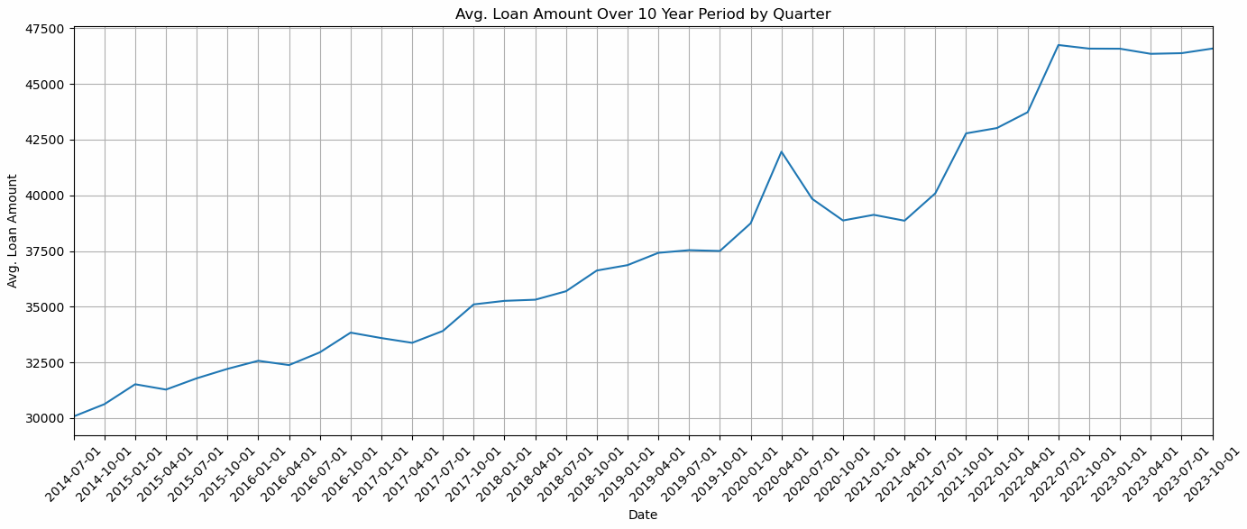
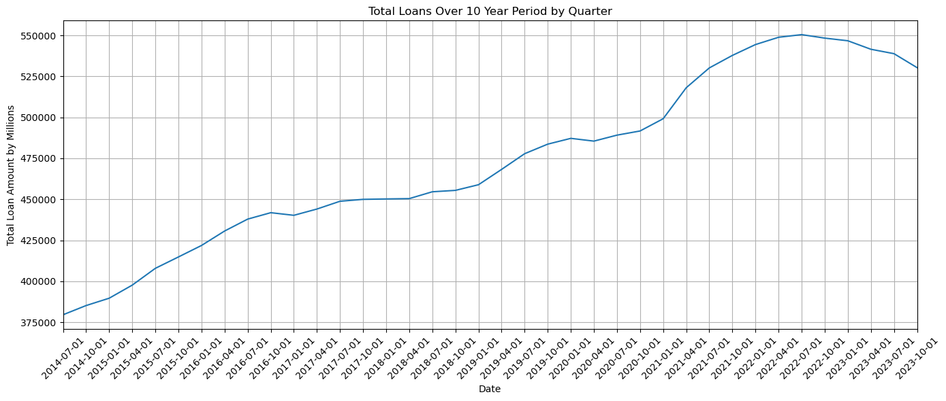
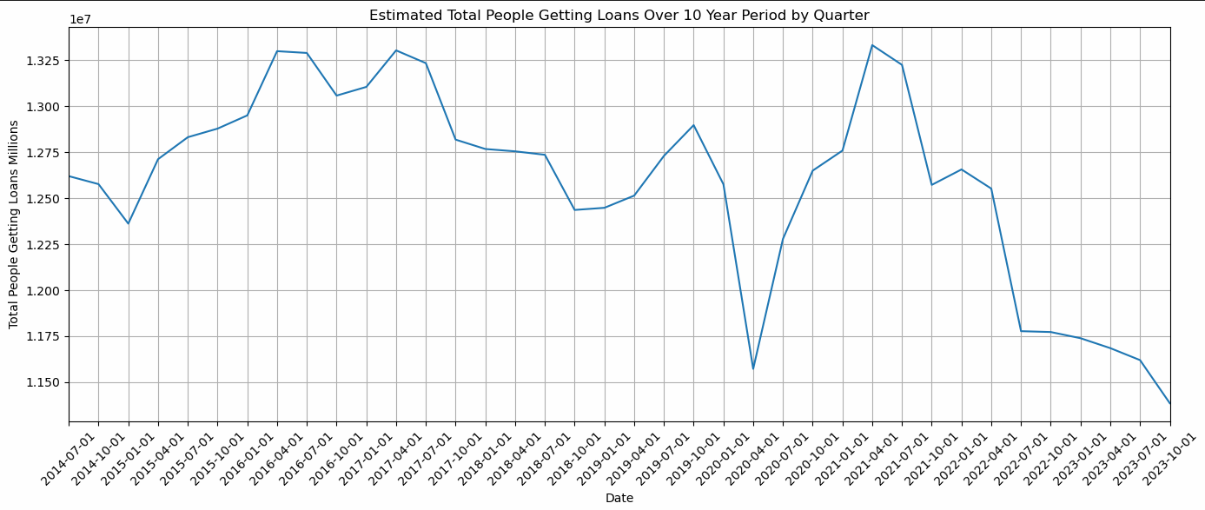
Avg Loans Per Person
1
2
COVID
3
Question: Within the noted timeframe, are the number of people taking out loans increasing or decreasing?
Analysis:
Average loan value was adjusted to include the interest from average rates.
The recalculated total loan amount was then divided by Combined loan amount.
Result: Estimated total number of people getting loans.
COVID

Slide 4

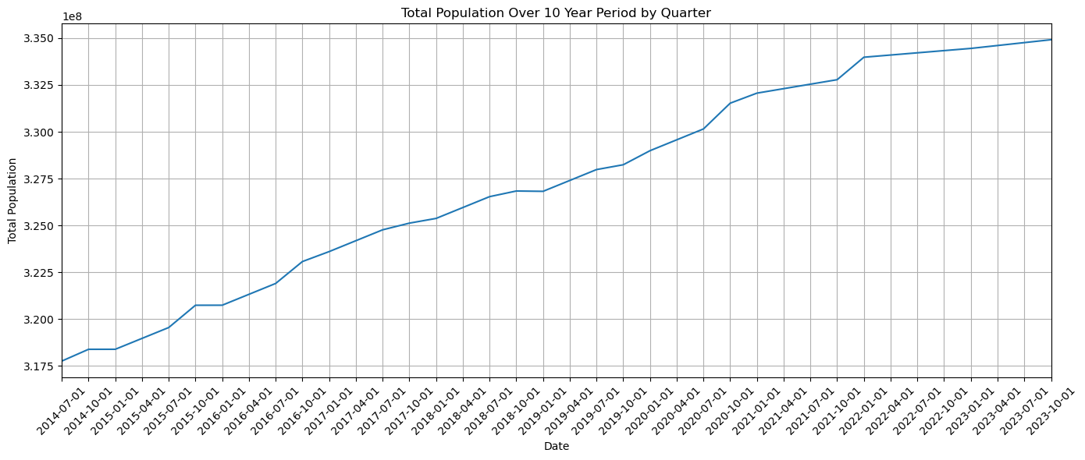
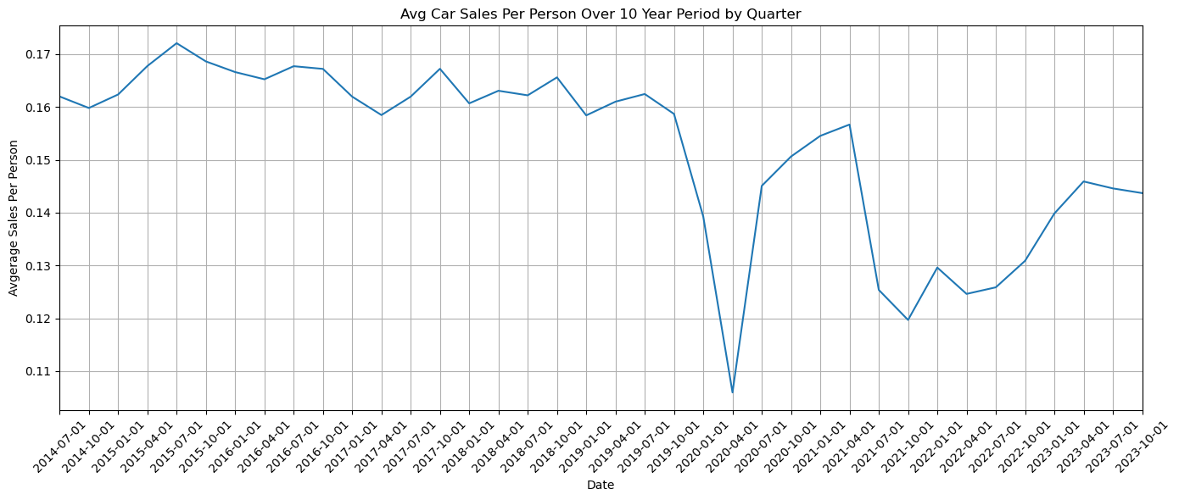
Avg Car Sales Per Person
1
Question: Has the number of people purchasing cars increased?
Analysis:
Total Population weighted against Total Vehicle Sales
Result: Average Car Sales per person.
2
COVID

Slide 5

1
Exploring the Correlation Between Loan Approvals and Car Purchases
COVID
Question: Do trends in loan approvals correlate with trends in car purchases?
Analysis:
There is opposite correlation; one can summarize as car sales increasing, car loans are having the opposite effect.
But why?.................
2
COVID

Slide 6
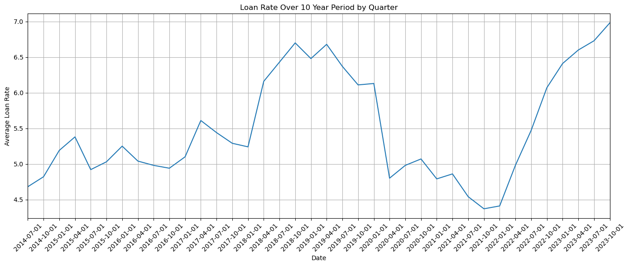
COVID
Exploring the Correlation Between Loan Approvals and Car Purchases – cont.
The divergence between car buying trends and auto loan acquisition is likely influenced by fluctuating loan rates, with periods of increasing rates typically corresponding to a decrease in the number of people obtaining auto loans.
COVID
COVID

Slide 7
Conclusion
Loan Rates
Correlations
Inconsistencies

